Slide 1

Be a Visuary
Data Visualization for Actuaries
2025.02.11
Enbo Jiang, FCAS, CERA

Slide 2
Antitrust Notice
The Casualty Actuarial Society is committed to adhering strictly to the letter and spirit of the antitrust laws. Seminars conducted under the auspices of the CAS are designed solely to provide a forum for the expression of various points of view on topics described in the programs or agendas for such meetings.
Under no circumstances shall CAS seminars be used as a means for competing companies or firms to reach any understanding – expressed or implied – that restricts competition or in any way impairs the ability of members to exercise independent business judgment regarding matters affecting competition.
It is the responsibility of all seminar participants to be aware of antitrust regulations, to prevent any written or verbal discussions that appear to violate these laws, and to adhere in every respect to the CAS antitrust compliance policy.

Slide 3
Disclaimers
The views and opinions expressed in this presentation are solely those of the presenter and do not necessarily reflect the official policy or position of the presenter’s employer or the Casualty Actuarial Society. Any opinions, findings, conclusions, or recommendations expressed in this presentation are those of the presenter alone and do not necessarily reflect the views of the presenter’s employer, the Casualty Actuarial Society, or any other organization or entity.
This presentation is for informational purposes only and does not constitute professional advice. While every effort has been made to ensure the accuracy and completeness of the information provided, the presenter makes no representations or warranties of any kind, express or implied, about the completeness, accuracy, reliability, suitability, or availability with respect to the content of this presentation. Any reliance you place on such information is therefore strictly at your own risk.
The presenter shall not be liable for any loss or damage arising from the use of, or reliance on, the information contained in this presentation, including, but not limited to, indirect or consequential loss or damage, or any loss or damage whatsoever arising from loss of data or profits arising out of, or in connection with, the use of this presentation.

Slide 4
Visuary
[noun]
An actuary who is thoughtful about communicating the numeric findings of actuarial analyses in visual forms.

Slide 5


Poll: What is your practice area?

Slide 6
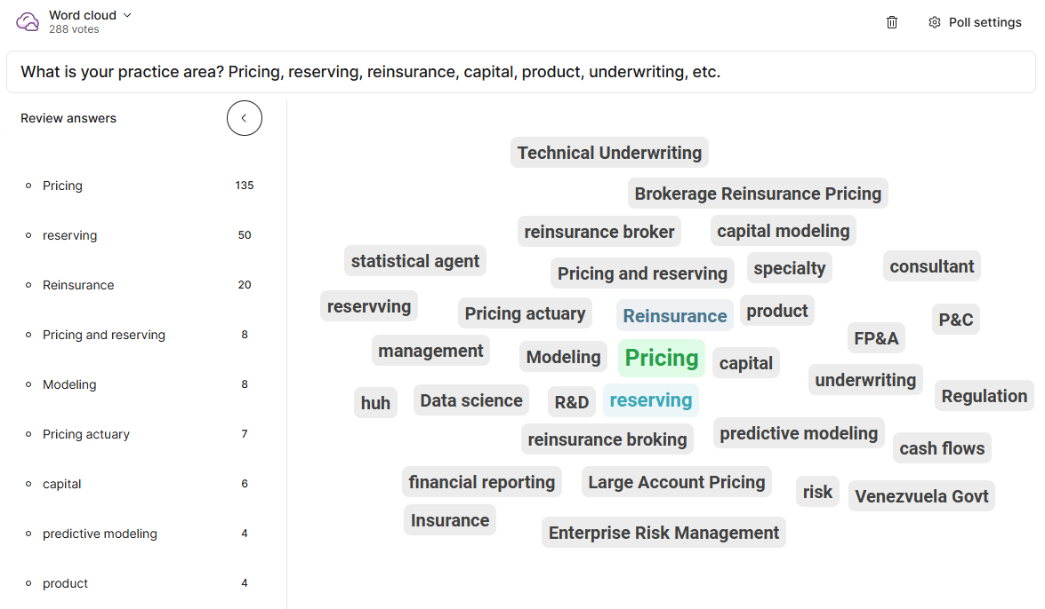

Slide 7
Agenda
Introduction
Theories and Principles
Applications
Design Execution
Contextual Awareness

Slide 8
Poll: How good are you at data visualization?
I am a data viz wiz
I am decently good at it
I get the job done but am pretty basic
I don’t visualize data but consume data visualizations
What is data?!

Slide 9
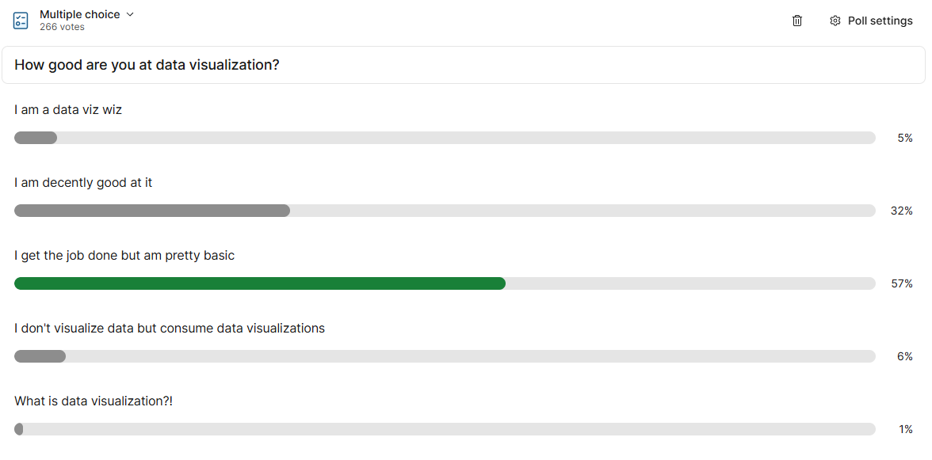

Slide 10
Poll: What is your go-to data visualization tool?

Slide 11
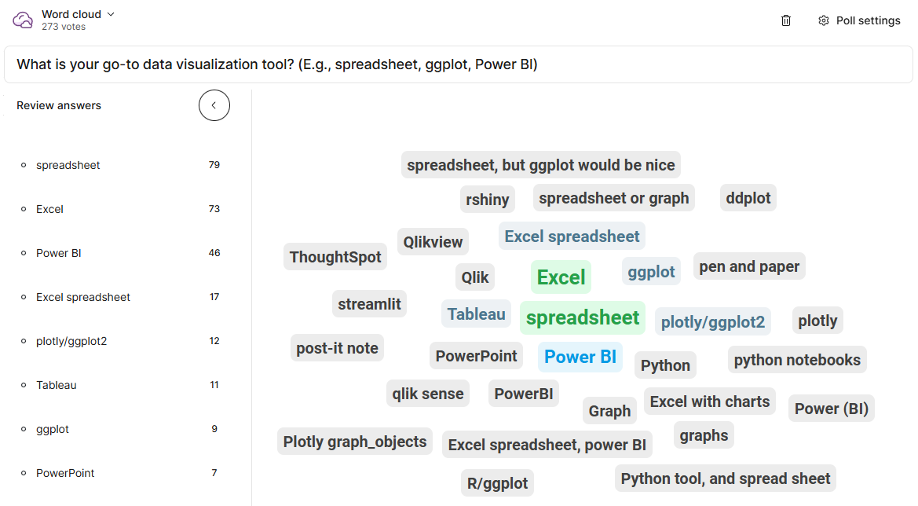

Slide 12
Introduction

Slide 13
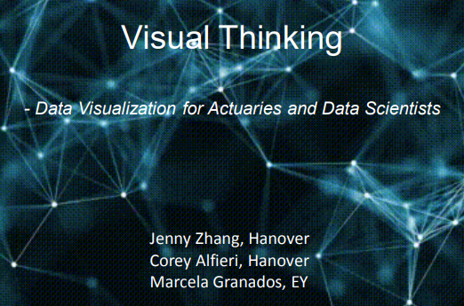
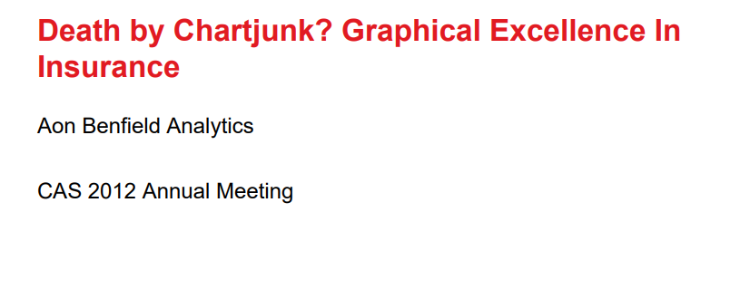
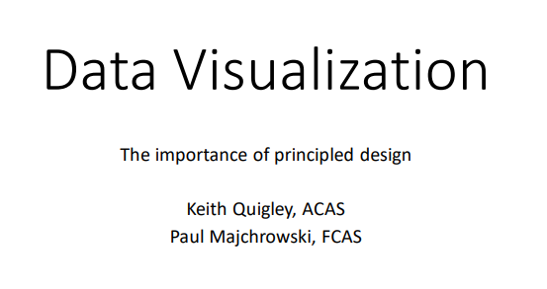
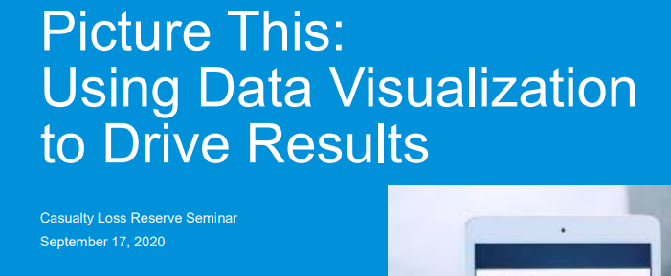
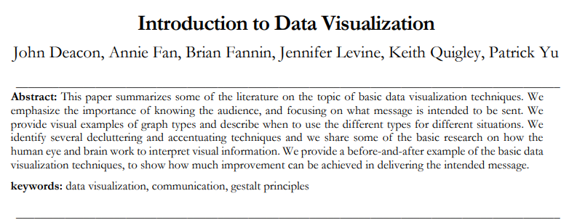
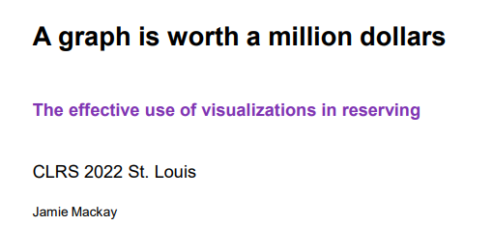
Not a new topic…

Slide 14
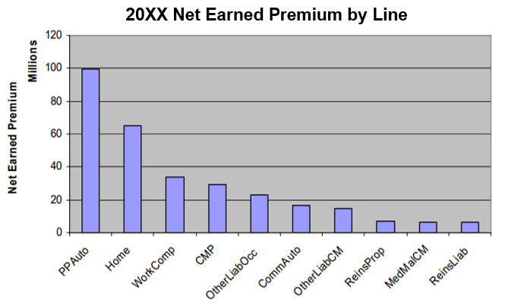
But still seeing this?
Annual Statement Data
Notes:
True story – a client report that my first employer wrote annually still showed a plot using the Excel 2003 theme in 2020…

Slide 15
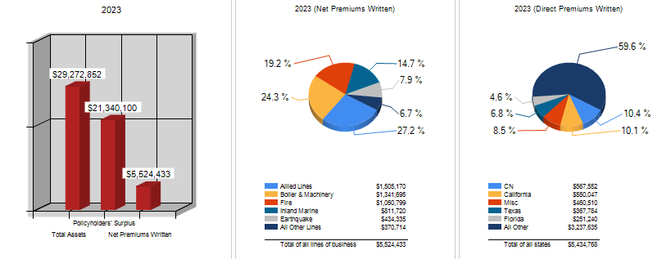
Or this?
An unnamed rating agency
Notes:
An unnamed rating agency’s reports

Slide 16
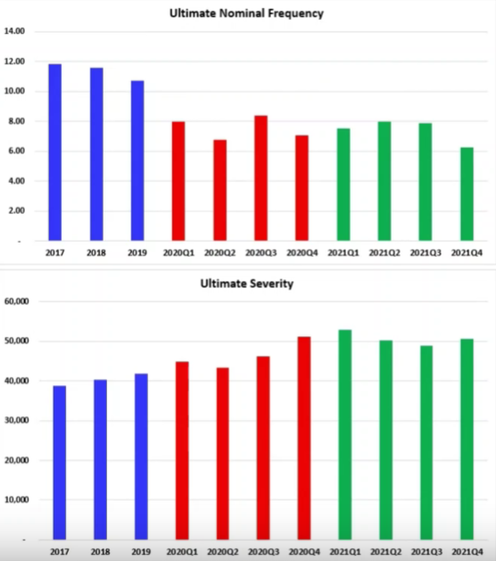
Or this?
An unnamed industry benchmark provider
Notes:
An unnamed industry benchmark publisher

Slide 17
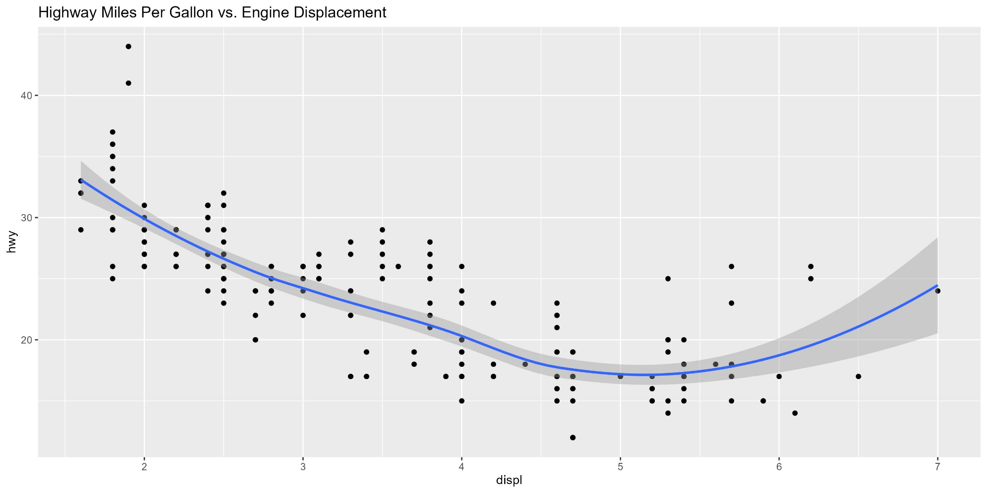
What about this?
https://ggplot2.tidyverse.org/reference/mpg.html
Notes:
ggplot default theme

Slide 18
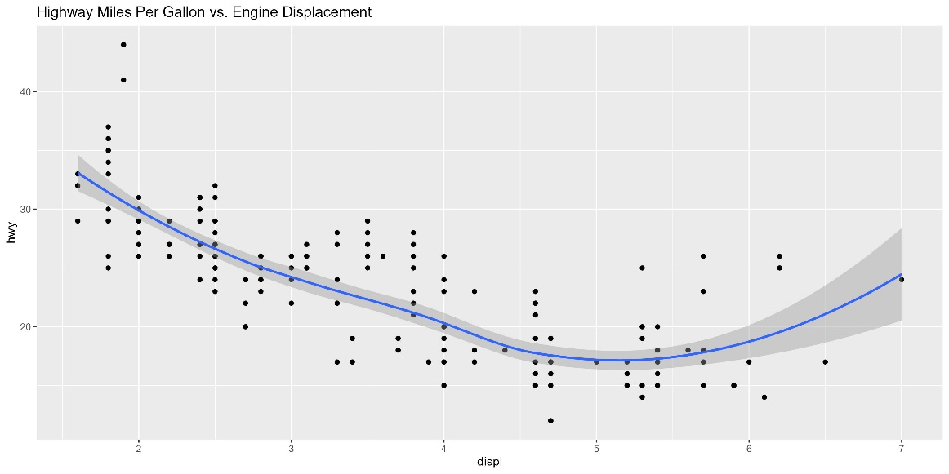
How can we do better?
Notes:
Unnecessary, distracting backgrounds
Improper units / decimal places
Tilted axis labels
3D
Raw RGB colors – could be okay in certain contexts, but not desirable in many professional publications
Mismatch of plot type and data type: Time series data are best plotted using lines rather than columns
Not showing the data (overplotting)

Slide 19
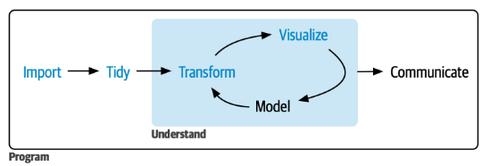
Why should we care?
Because “visualize” is an integral part of the actuarial/data modeling process, and arguably it’s critical to every step of the process
R for Data Science (2e) - Whole game (hadley.nz)

Slide 20
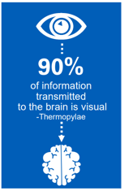
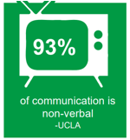
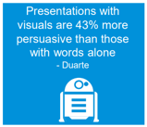
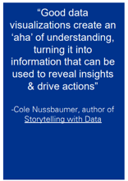
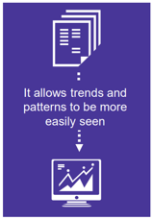
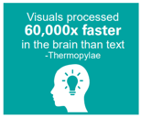
Why should we care?
Because good visualization could enhance effectiveness of communication
cs17-picturethis_usingdatavisualizationtodriveresults-fileid-255085.pdf

Slide 21
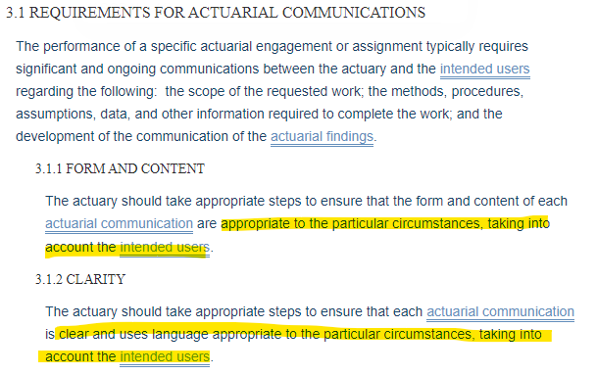
Why should we care?
Because we are actuaries and ASOPs says…
Visualization may be the most appropriate “language” in certain circumstances for the intended users
Actuarial Communications - Actuarial Standards BoardActuarial Standards Board

Slide 22
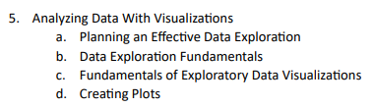
Not a new topic, so what’s new(-ish)?
Data visualization wasn’t part of the exam syllabus at all until very recently through the new online course
Growing popularity of new and free tools (i.e., R, Python) that come with much more robust visualization libraries than Excel
CAS DISC DA Syllabus (casact.org)
Notes:
Experienced actuaries need the continuing education to be excellent at visualizations

Slide 23
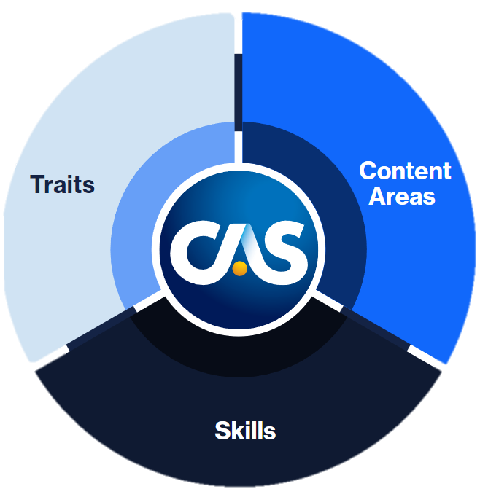
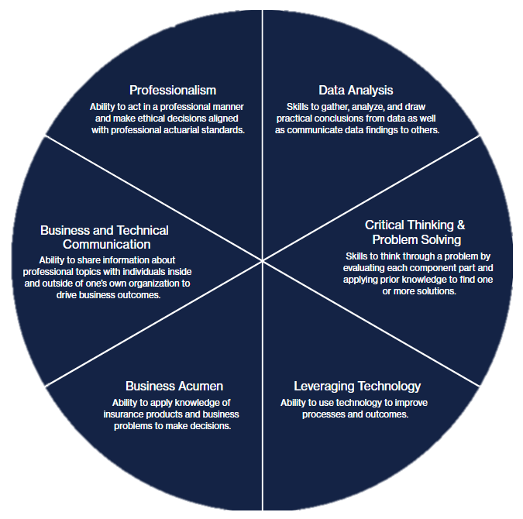
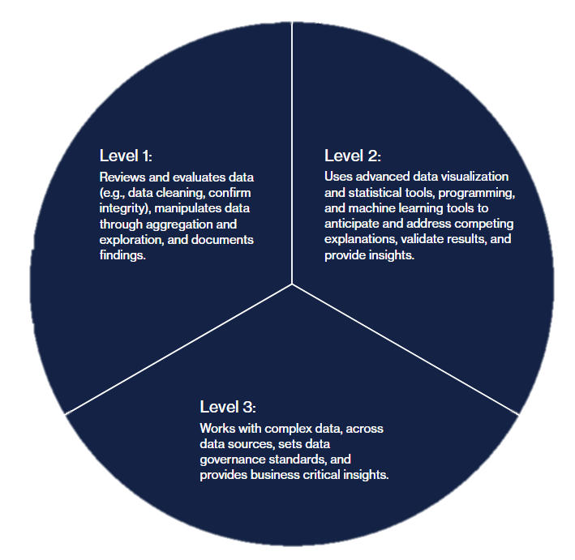
CAS Capability Model
CAS Capability Model | Casualty Actuarial Society (casact.org)

Slide 24
Main learning objectives
Understand basic theories and principles of data visualization and what constitutes a “Good Chart”
Apply the learning from this session to create desired visuals. We will use ggplot for practical demonstration, but the same principles can be extended to other platforms
Evaluate the appropriateness of a visualization in a given context and propose ways to improve it

Slide 25
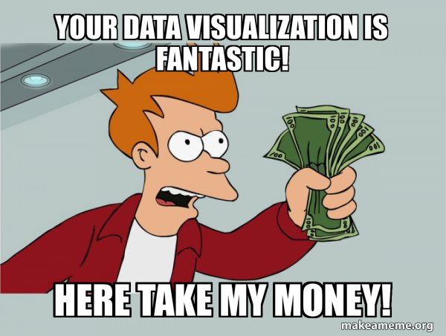
What this session is not
A tutorial/workshop for ggplot, Power BI, etc.
Choose your favorite tool, though we will be using ggplot for demonstration of the principles discussed herein
A sales pitch on why and how your organization should set up a more efficient dashboard system
Consultants are more than happy to take your money and help you with that

Slide 26
Theories and Principles

Slide 27
Tufte’s Graphical Excellence
Graphical excellence is that which gives to the viewer the greatest number of ideas in the shortest time with the least ink in the smallest space
The famous “data-ink ratio” stems from this
Higher data “density,” if you will
Graphical excellence requires telling the truth
…
“…above all else, show the data”
Graphical/Visual Properties (gatech.edu)

Slide 28
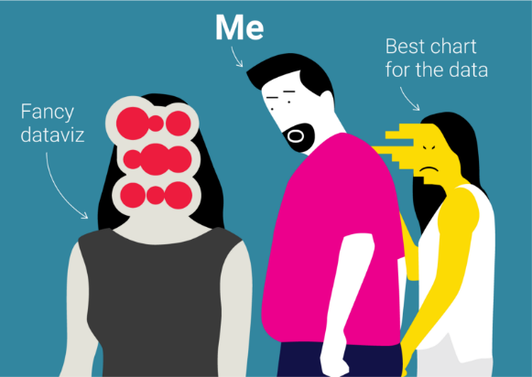
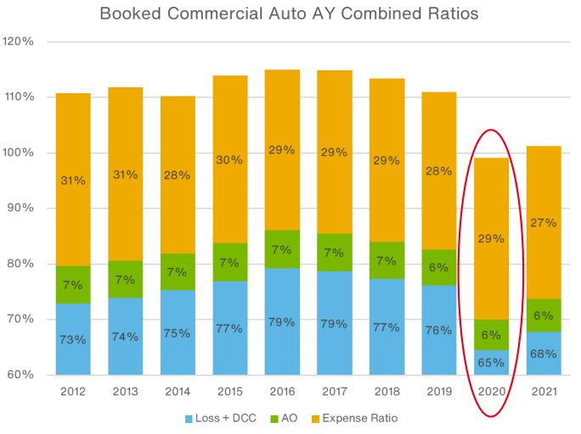
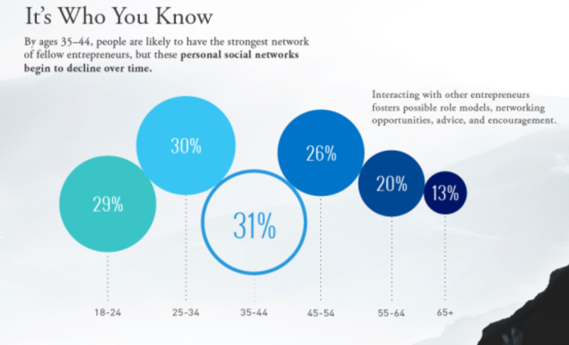
Visuaries do not mislead
“Graphical excellence requires telling the truth about the data.”
Visual Display of Quantitative Information pg. 51
Obvious
Subtle
PowerPoint Presentation (casact.org)
Tools - Proportional Ink (callingbullshit.org)
Notes:
Most of us are aware of the distortion introduced by cropped y-axis to the left. The “fancier” bubble chart to the right is a subtler version of the same problem: Visually, 31% is disproportionately larger than 13% because we tend to perceive area rather than diameter for circles.

Slide 29
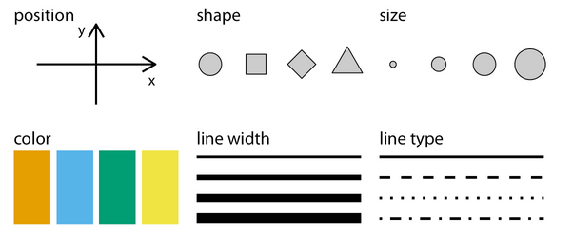
Visuaries employ intentional aesthetics
“Aesthetics”
aes() in ggplot
Combine colors with other aesthetics to ensure plot remains interpretable when printed black-and-white and for colorblind audience
There are also colorblind-proof palettes available, e.g., Okabe-Ito
Fundamentals of Data Visualization (clauswilke.com)

Slide 30
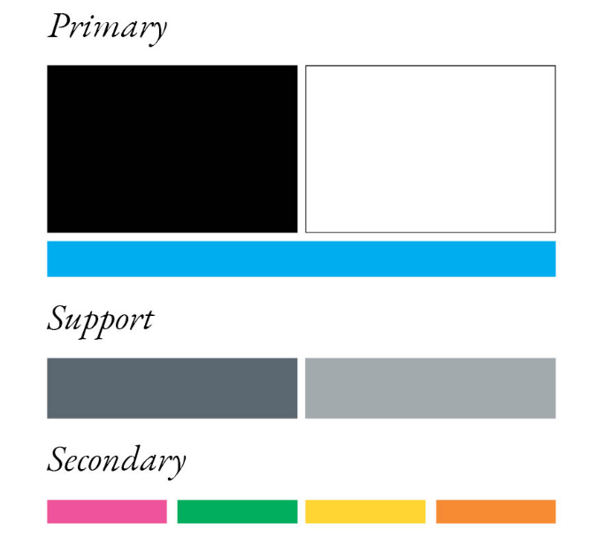
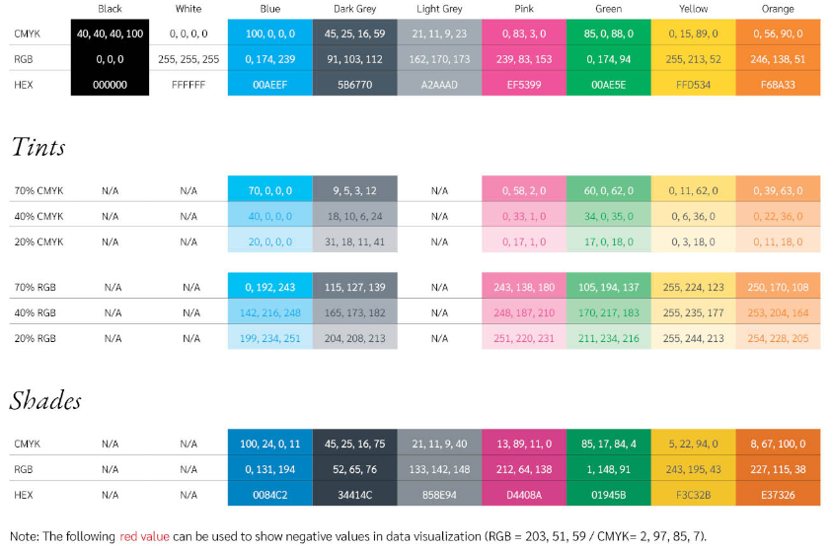
Color Considerations
Usually dictated by your companies’ themes
If so, be on-brand!
If not, understand the use cases:
Categories (qualitative), numeric values (sequential/diverging), highlight
Lockton Online

Slide 31
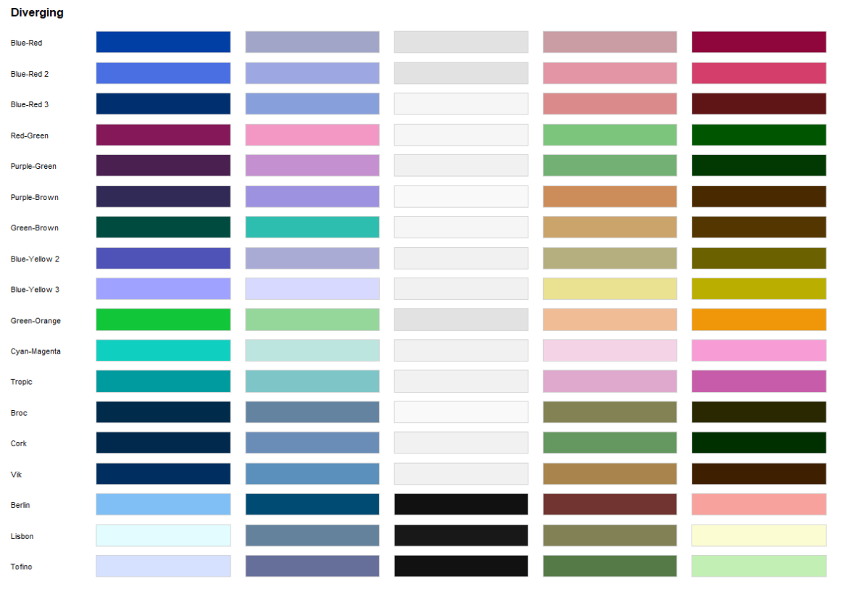
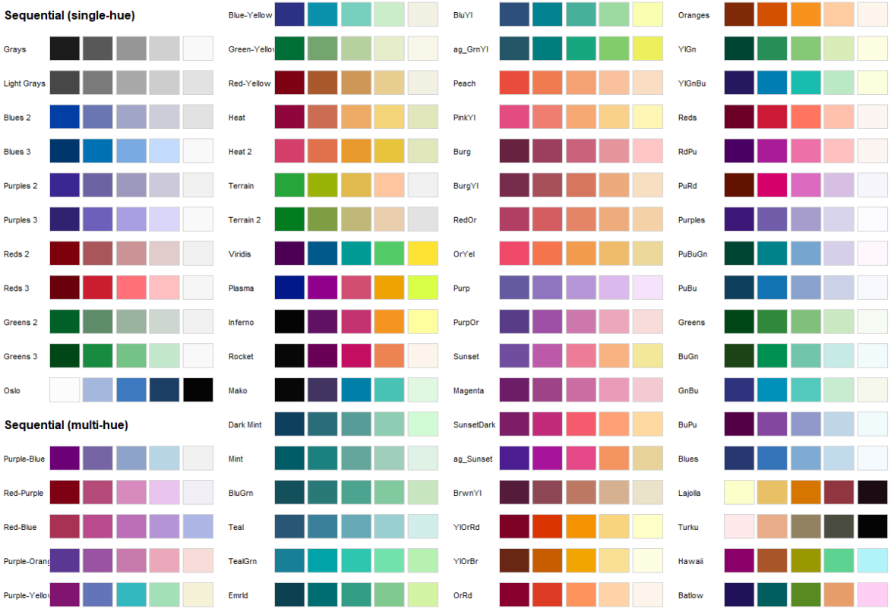
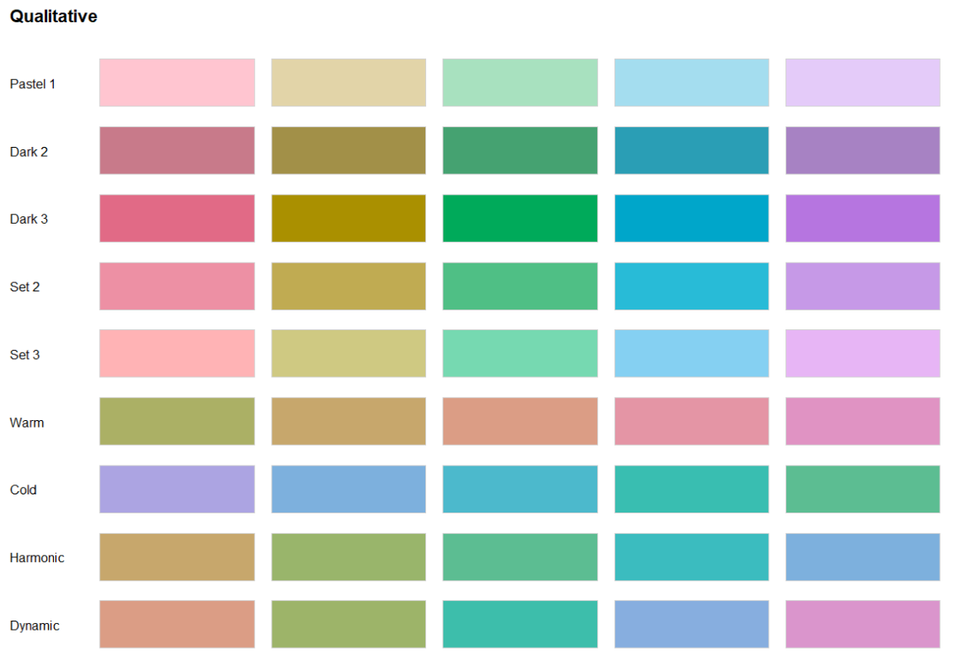
Color Considerations
colorspace::hcl_palettes(type = "Sequential", plot = TRUE)
colorspace::hcl_palettes(type = "Diverging", plot = TRUE)
colorspace::hcl_palettes(type = "Qualitative", plot = TRUE)

Slide 32
Visuaries design excellently and contextually
Design Execution
Excellent
Good Charts
Contextual
Awareness
Low
High
Poor
Good Charts (scottberinato.com)

Slide 33
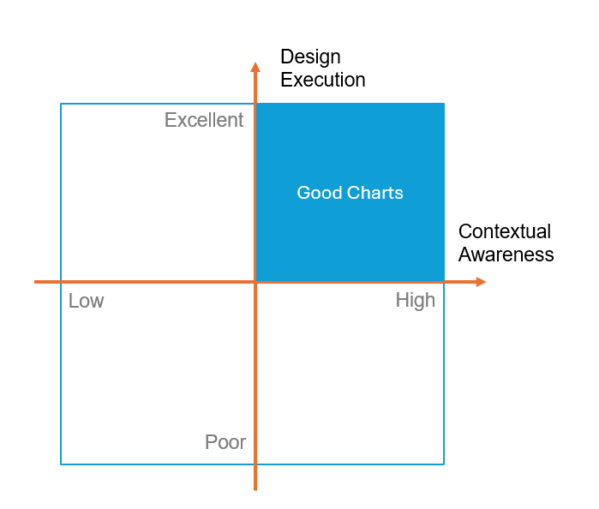
Design Execution
Reproducible R script available on GitHub

Slide 34
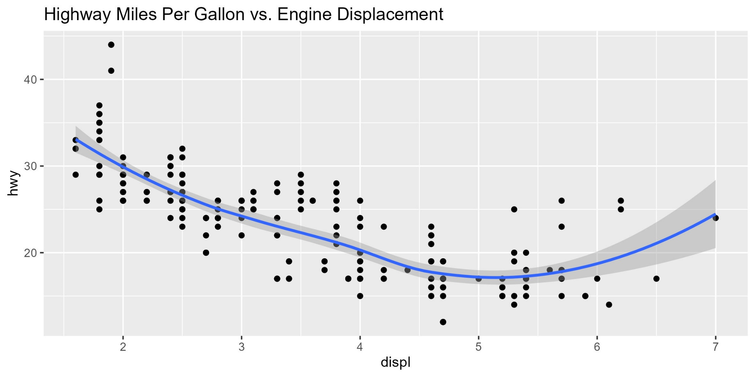
Original
> How would you improve this plot?

Slide 35
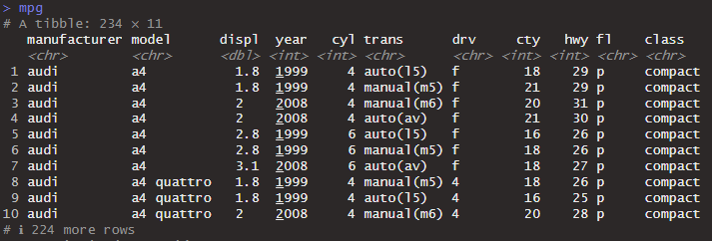
Step 1: Look at your data!

Slide 36
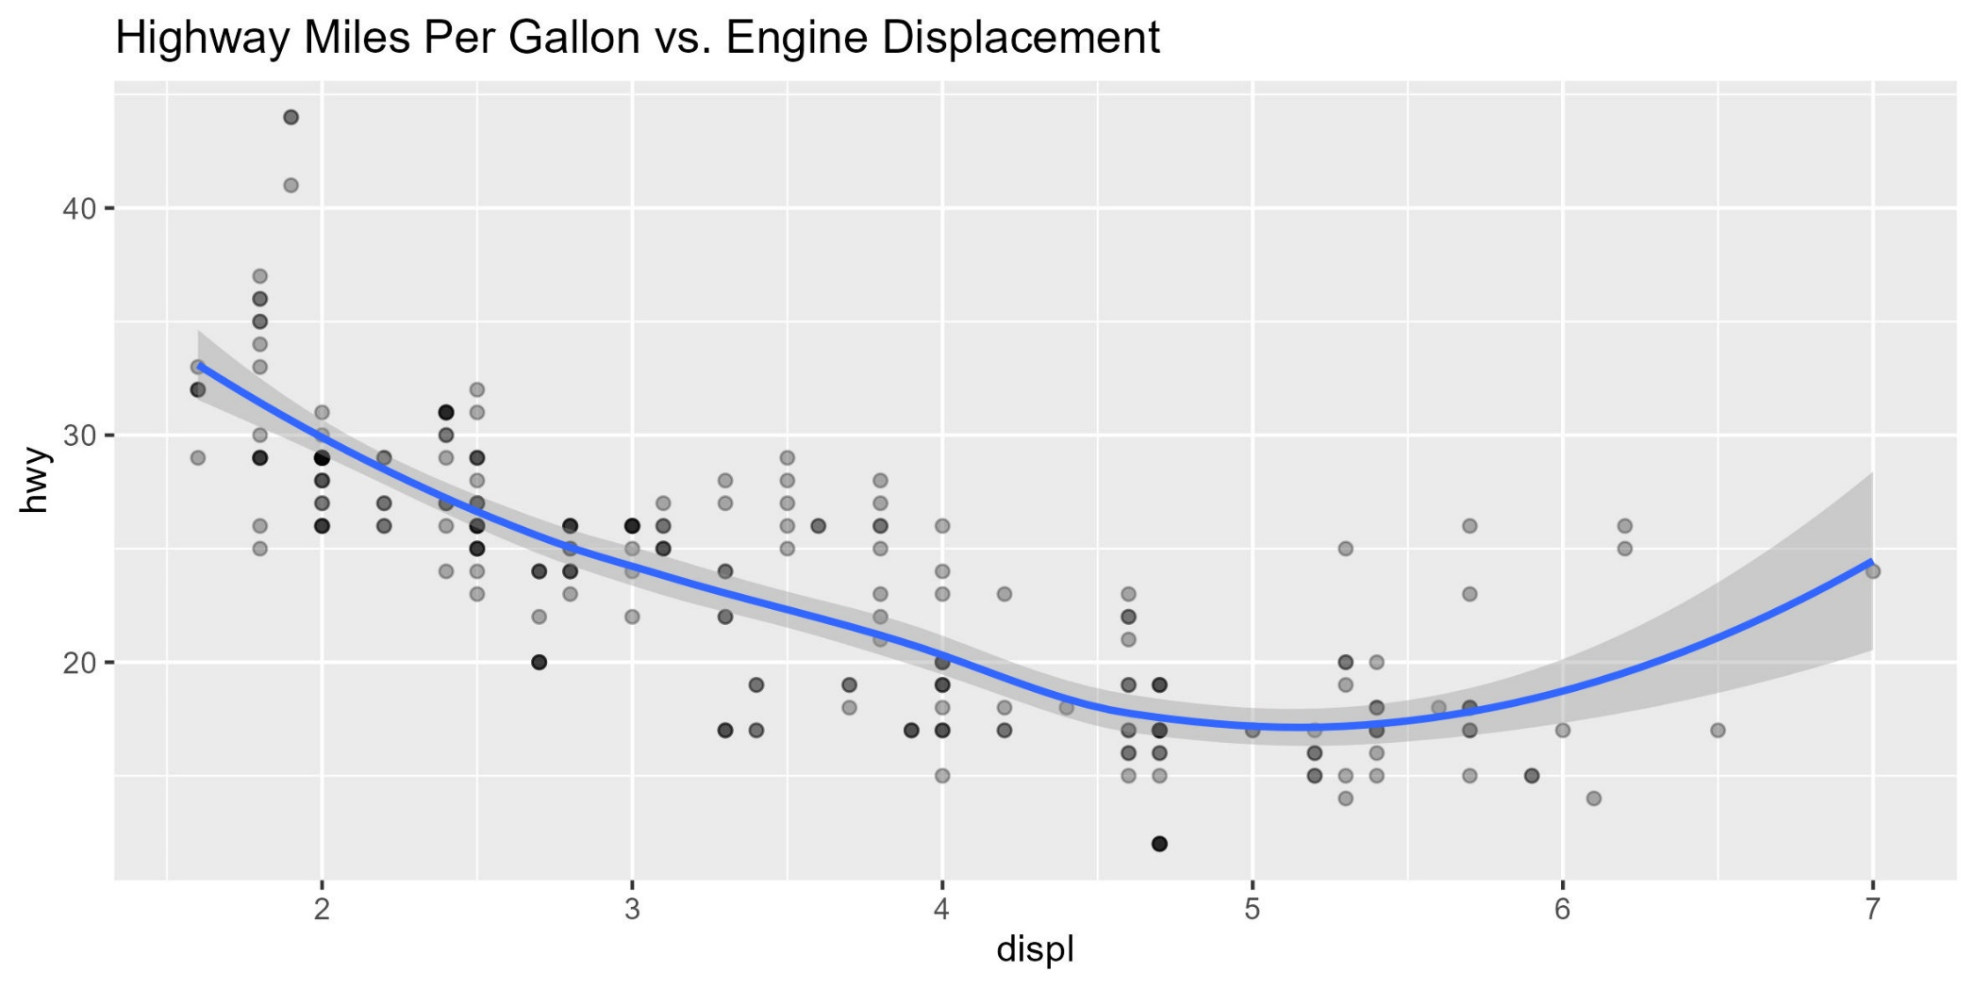
Intentional aesthetics - transparency
> “…above all else, show the data”

Slide 37
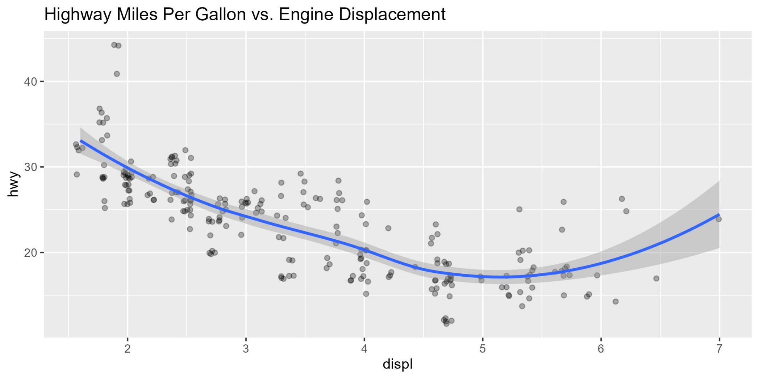
Intentional aesthetics - position

Slide 38
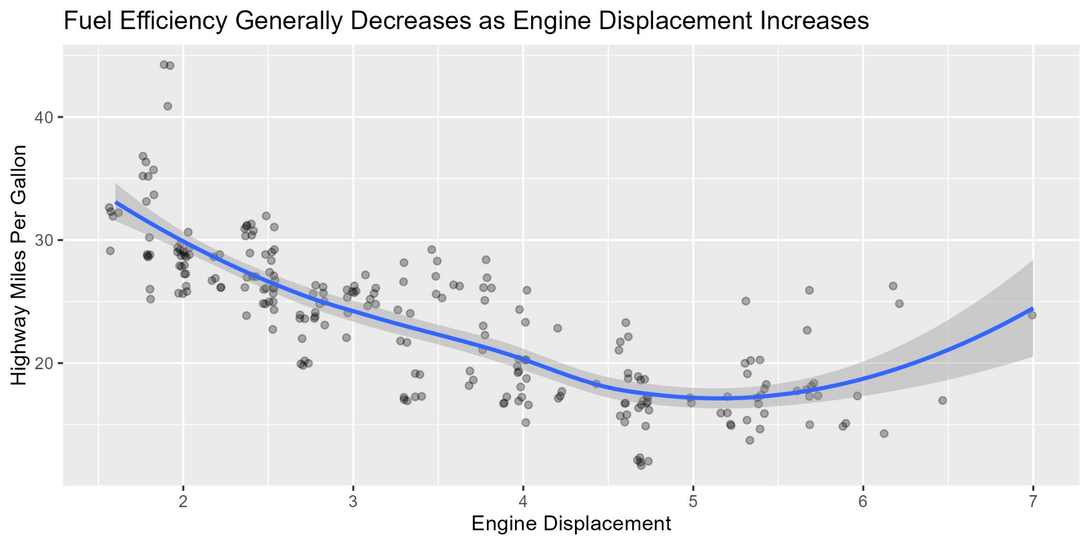
Descriptive labels and a storytelling title

Slide 39
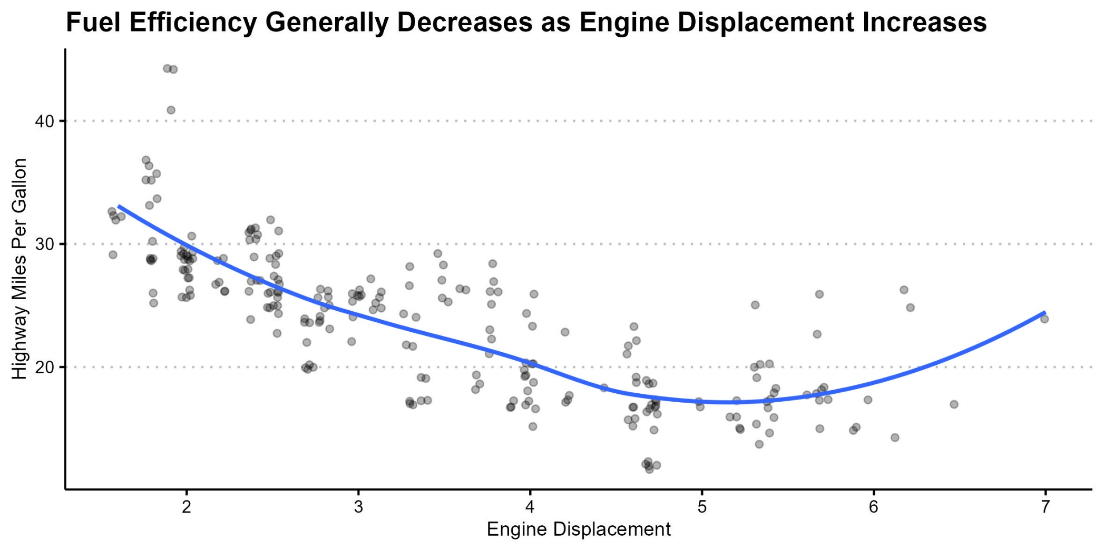
Remove distractions

Slide 40
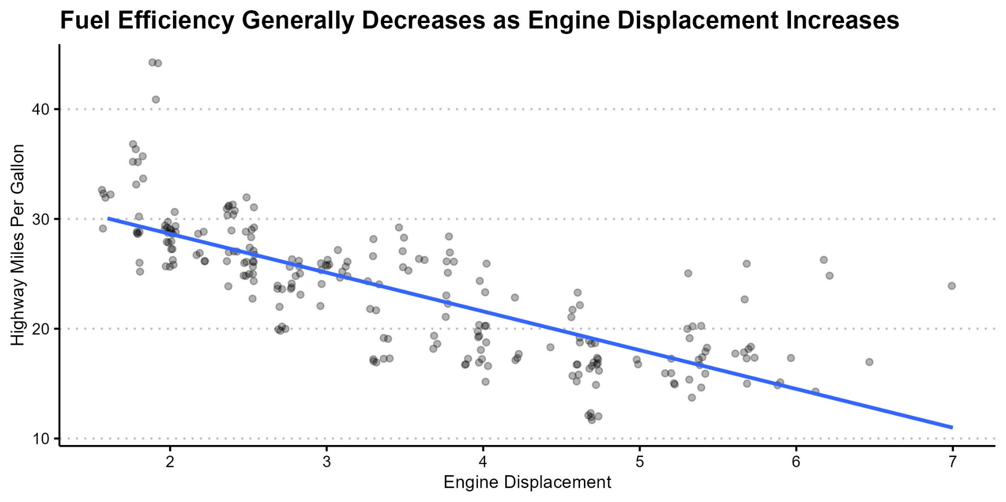
Simpler trend line
Stick to the message

Slide 41
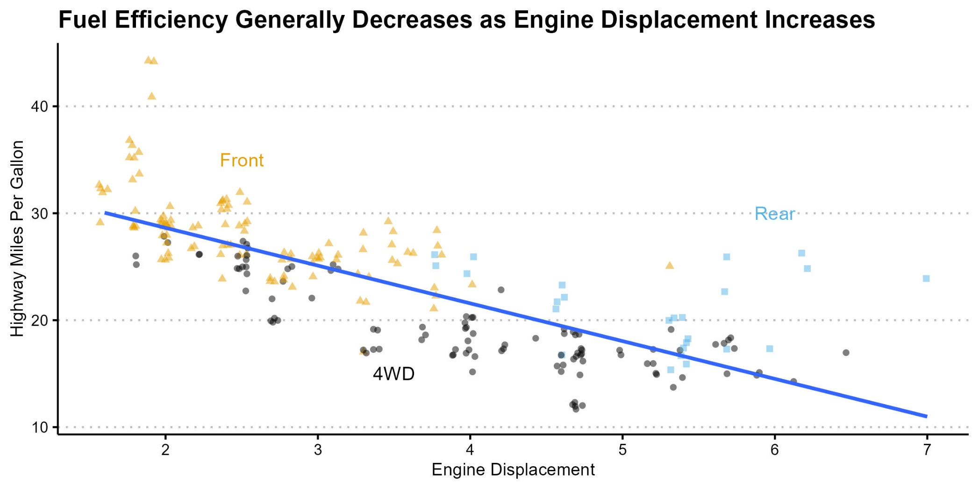
Increase data density – aesthetics

Slide 42
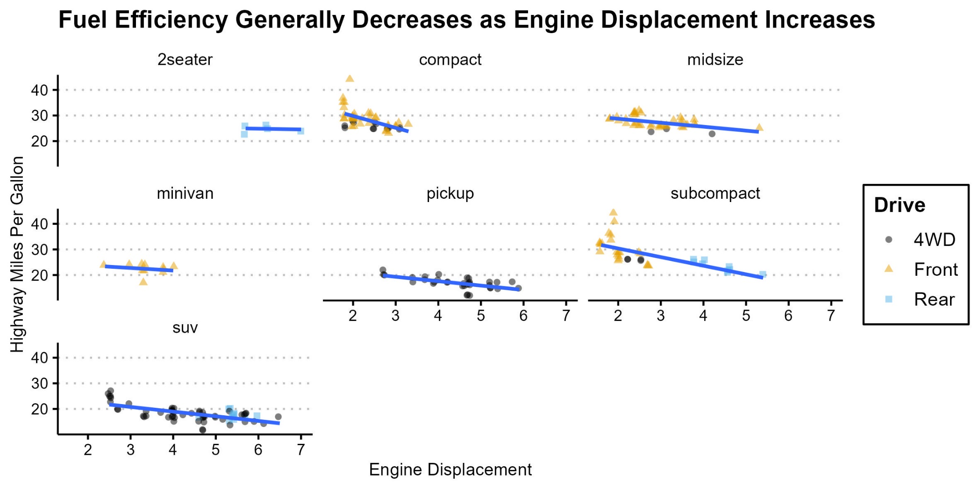
Increase data density – facets
> Why should we not use alphabetical ordering for the panels?

Slide 43
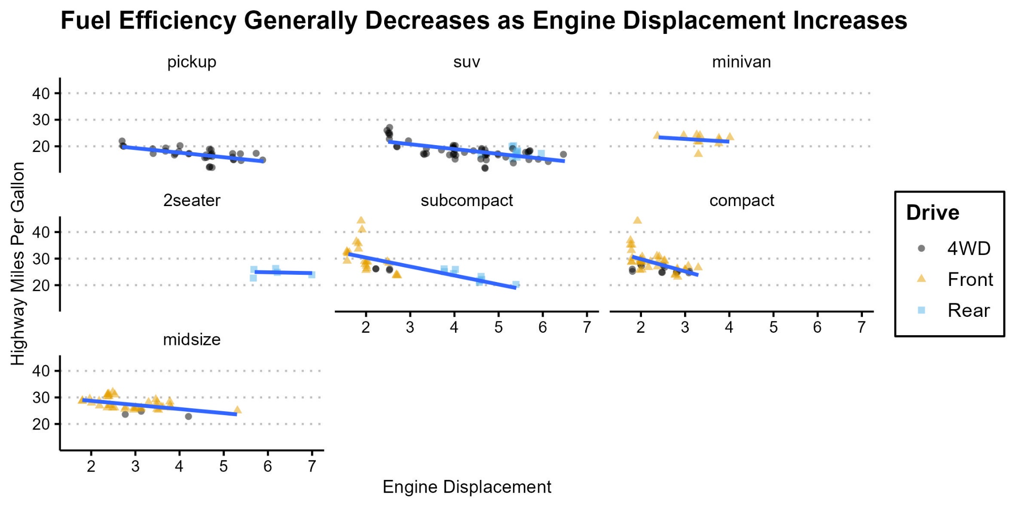
Increase data density – order matters
> Order panels by median Highway MPG of each class

Slide 44
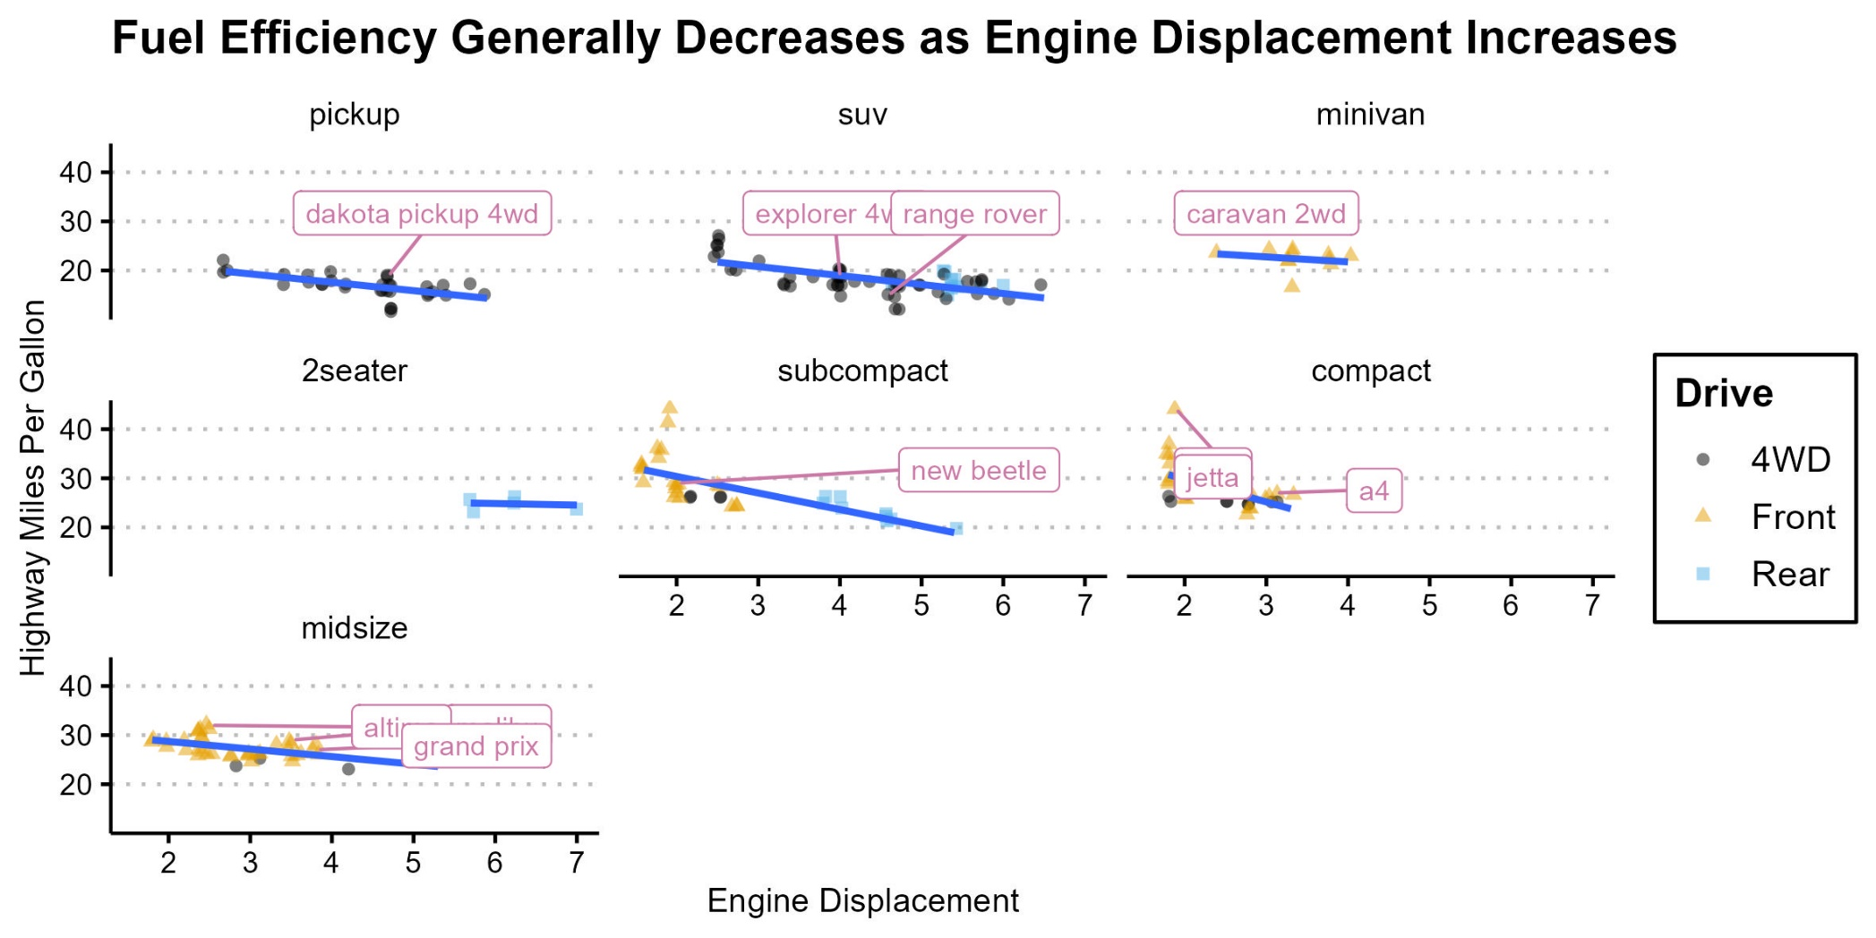
Labels - static
> Helpful but too busy. Anything else we could do?

Slide 45
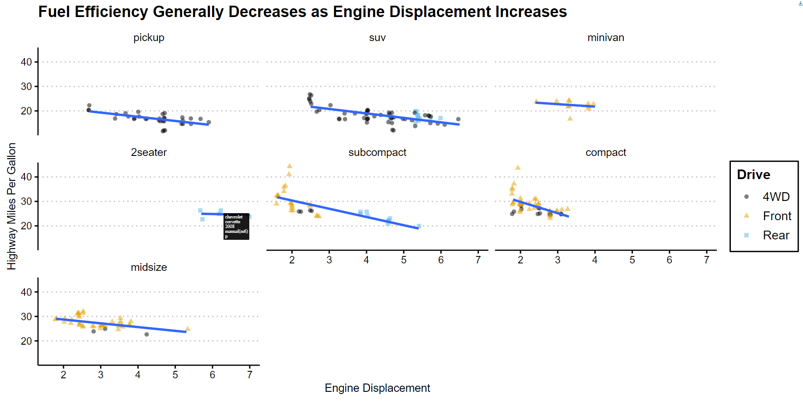
Labels - interactive

Slide 46
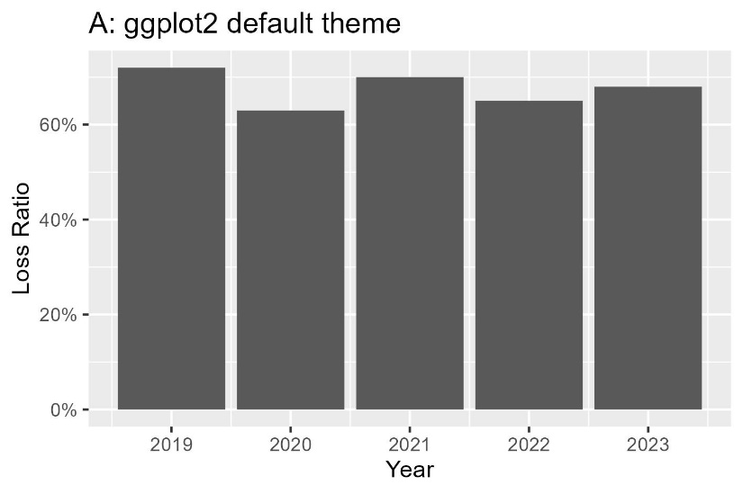




Poll: Which of the following charts appeals to you the most?

Slide 47


Slide 48
Contextual Awareness

Slide 49
Contextual Awareness
What?
Who?
When?
Where?
How?
Amounts
Distributions
Proportions
Multivariate relationship
Geospatial
Uncertainty
Actuaries
Non-actuaries (UW, brokers, management)
Regulators
Data exploration phase
Modeling phase
Results communication phase
Board meeting
Industry conference
Internal team standup call
Oral presentation (verbally explained)
Written report (textually explained)
Infographics (self-explanatory)

Slide 50
Is doughnut chart just pie chart with arbitrarily better data-ink ratio?
Notes:
Data-ink ratio is just a general guidance. Like BMI ratio, it is a simple metric that is useful but don’t capture the whole story.

Slide 51

Poll: Should doughnuts and pies be avoided?
Yes, avoid at all costs
They are mostly useless, but…
They work well most of the time, but…
Don’t avoid, they are very useful

Slide 52


Slide 53
You may strongly dislike pie charts… But if your principal loves pie charts, use pie charts despite your “visuarial” judgment. “…taking into account of the intended users.” – ASOP No. 41

Slide 54



The “what”
Practice thoughtfulness:
As we flip through these chart types, consider the “who, when, where, and how” to which each of these charts would be appropriate and effective.
Amounts
Fundamentals of Data Visualization (clauswilke.com)
Notes:
Goal here is to make the audience pause and think about the “best” plot for each context, rather than prescribing what is the “best”, to develop a more thoughtful approach to choosing the most appropriate for different contexts.

Slide 55


The “what”
Practice thoughtfulness:
As we flip through these chart types, consider the “who, when, where, and how” to which each of these charts would be appropriate and effective.
Single distribution
Fundamentals of Data Visualization (clauswilke.com)
THE MATHEMATICS OF EXCESS OF LOSS COVERAGES AND RETROSPECTIVE RATING-A GRAPHICAL APPROACH (casact.org)

Slide 56



The “what”
Practice thoughtfulness:
As we flip through these chart types, consider the “who, when, where, and how” to which each of these charts would be appropriate and effective.
Multiple distributions
Fundamentals of Data Visualization (clauswilke.com)

Slide 57



The “what”
Practice thoughtfulness:
As we flip through these chart types, consider the “who, when, where, and how” to which each of these charts would be appropriate and effective.
Proportions
Fundamentals of Data Visualization (clauswilke.com)

Slide 58




The “what”
Practice thoughtfulness:
As we flip through these chart types, consider the “who, when, where, and how” to which each of these charts would be appropriate and effective.
Multivariate relationships
Fundamentals of Data Visualization (clauswilke.com)

Slide 59

The “what”
Practice thoughtfulness:
As we flip through these chart types, consider the “who, when, where, and how” to which each of these charts would be appropriate and effective.
Geospatial
Fundamentals of Data Visualization (clauswilke.com)

Slide 60



The “what”
Practice thoughtfulness:
As we flip through these chart types, consider the “who, when, where, and how” to which each of these charts would be appropriate and effective.
Uncertainty
Fundamentals of Data Visualization (clauswilke.com)

Slide 61




Poll: You want to communicate that a distribution is more heavy-tailed than the other. Which plot below would you choose for an actuarial audience?

Slide 62


Slide 63
Poll: You want to communicate that a distribution is more heavy-tailed than the other. Which plot below would you choose for a non-actuarial audience?

Slide 64


Slide 65


Poll: You want to communicate to management that your new predictive model is superior at differentiating high-cost policyholders from the low-cost ones. Which plot would you choose?
rpm_2016_presentations_pm-lm-4.pdf (casact.org)

Slide 66


Slide 67

What I think of every time I see a double lift chart…
“Don’t design your visuals to be just clever or different. Design them so that they solve the problem in a materially improved, intuitive way.” – Jamie Mackay

Slide 68
So… how can we do better?
Notes:
Unnecessary, distracting backgrounds
X-axis labels are tilted. When titled, consider flipping the coordinates so that the texts are horizontal on the y-axis, which is easier to read

Slide 69


Slide 70
So… how can we do better?
Notes:
Pie charts…
3D

Slide 71


Slide 72
So… how can we do better?
Notes:
Generic title – try to tell as story with your title
Raw RGB colors – could be okay in certain contexts, but not desirable in many professional publications
Red/green colorblind considerations
Mismatch of plot type and data type: Time series data are best plotted using lines rather than columns
Blue columns are years, but red and green are quarters

Slide 73


Slide 74
Conclusion – Be a Visuary
We should value good data visualization
We can apply well researched design principles to improve the quality of charts
We need to be contextually aware and thoughtful when choosing and designing visualization

Slide 75
Poll: Out of everything that we discussed, what was the most impactful to you?

Slide 76


Slide 77




Thank you!
enbo.jiang@lockton.com
https://www.linkedin.com/in/enbojiang/
https://github.com/enbojiang/cas-talks
This Photo by Unknown Author is licensed under CC BY-NC

